Slide 1


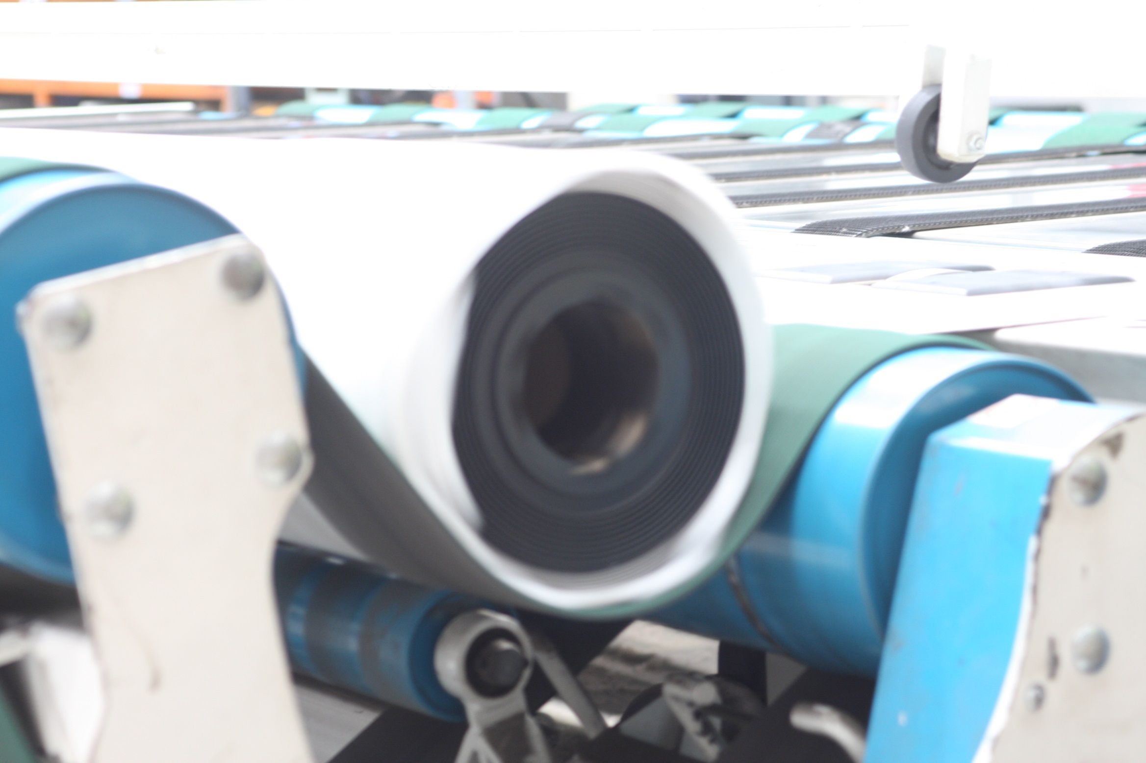
GMK LOGISTICS (GMK) – NATIONAL WAREHOUSING AND TRANSPORT SERVICES PROPOSAL FOR TARKETT AUSTRALIA PTY LTD
10 September 2015

Slide 2


SAFETY MOMENT
2

Slide 3
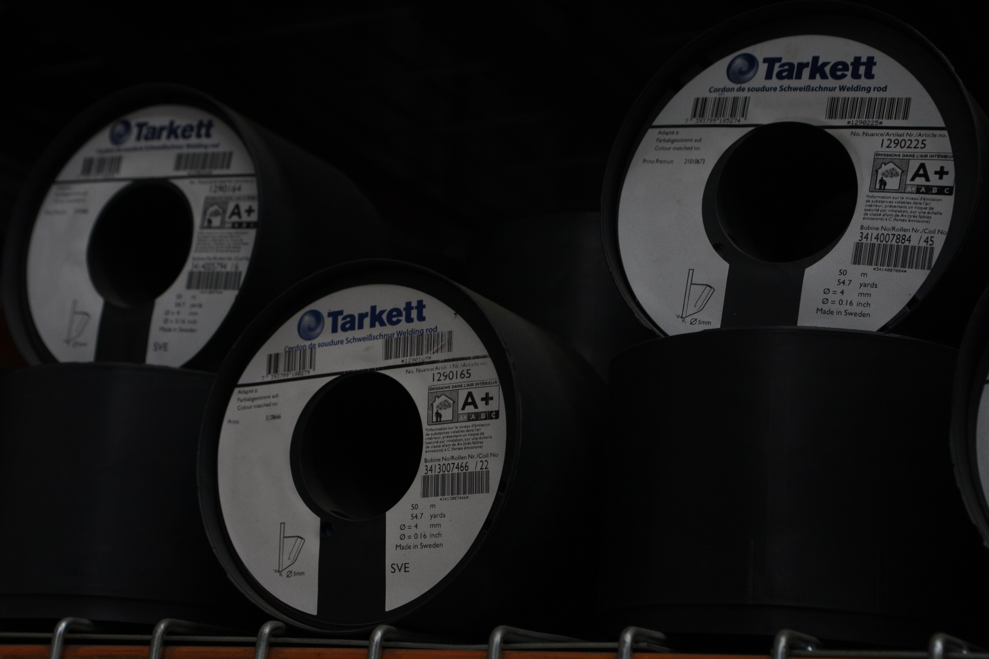


TARKETT REQUIREMENTS
  Tarkett has made the decision to outsource their national warehousing and distribution operation to a specialist logistics provider
  Commencement date to be July 2016
  GMK’s understanding of Tarkett’s requirements is as follows:
  Main warehouse to be Sydney based, with national distribution from that location
  Storage of approximately 3,000 pallets nationally with full pick and pack function
  Storage of approximately 10,000 rolls of vinyl nationally with full pick, cut and pack function
3

Slide 4
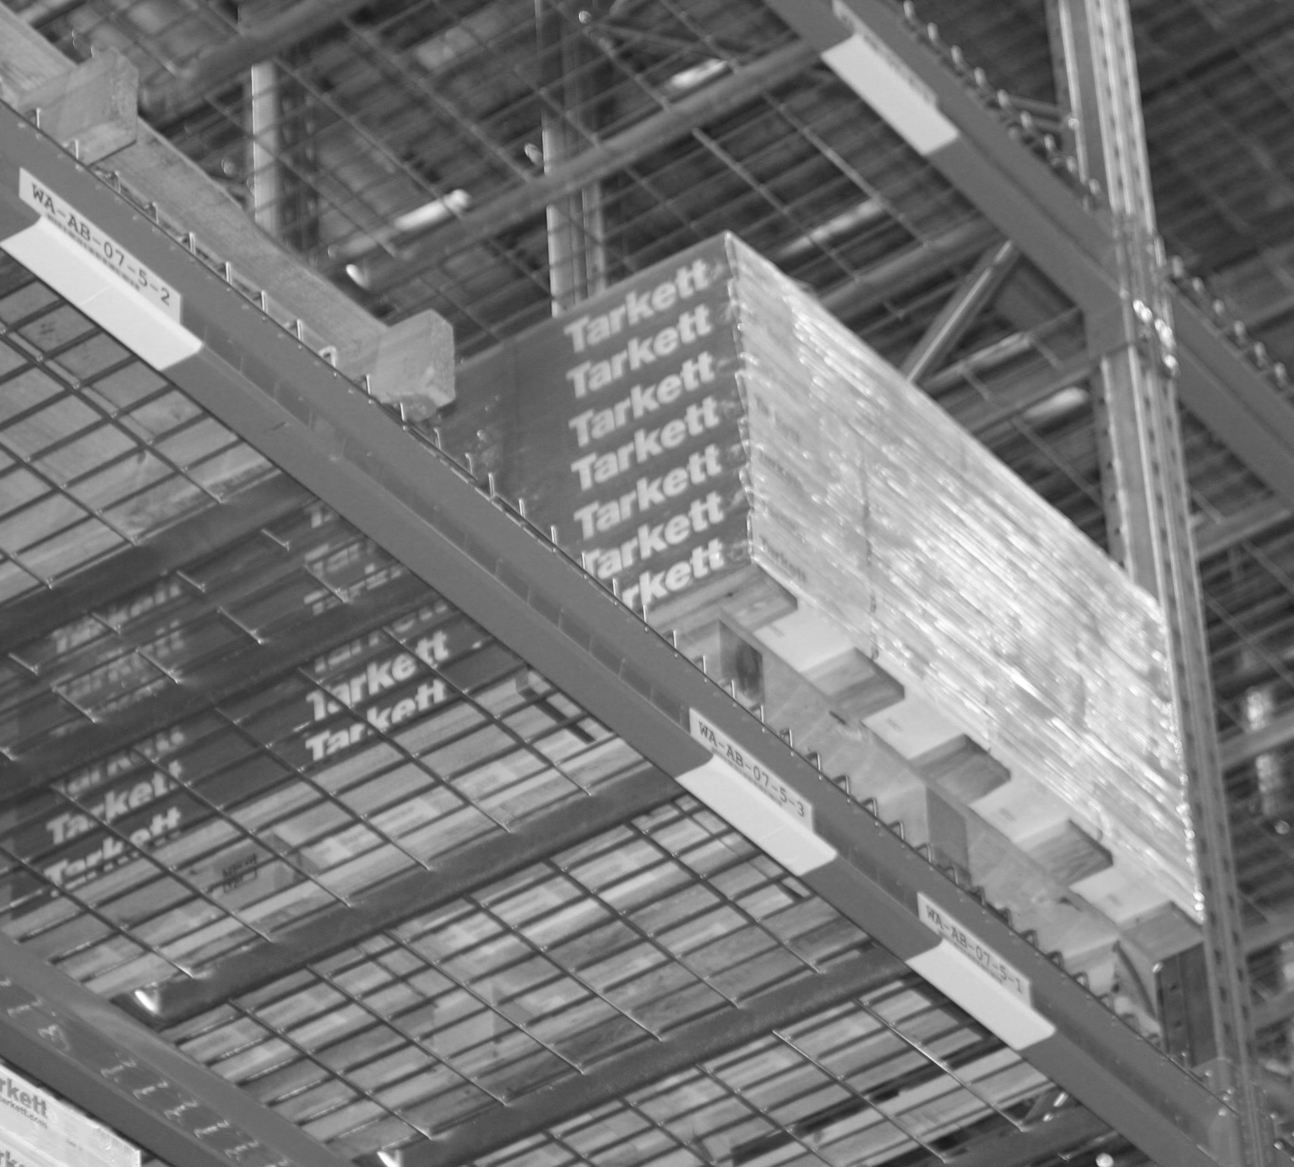
TARKETT KEY OBJECTIVES
  National distribution system focused on delivery of products on time, every time in first class condition to support Tarkett’s goal of providing outstanding customer service
  A distribution system that can provide same day metropolitan delivery in all capital cities as well as seamless and efficient stock transfers between states
  Uniform national pricing structure
  A distribution model that will deliver reduced operating costs
  Possible employment for existing Tarkett warehouse staff and purchase of existing Tarkett warehouse equipment
4

Slide 5
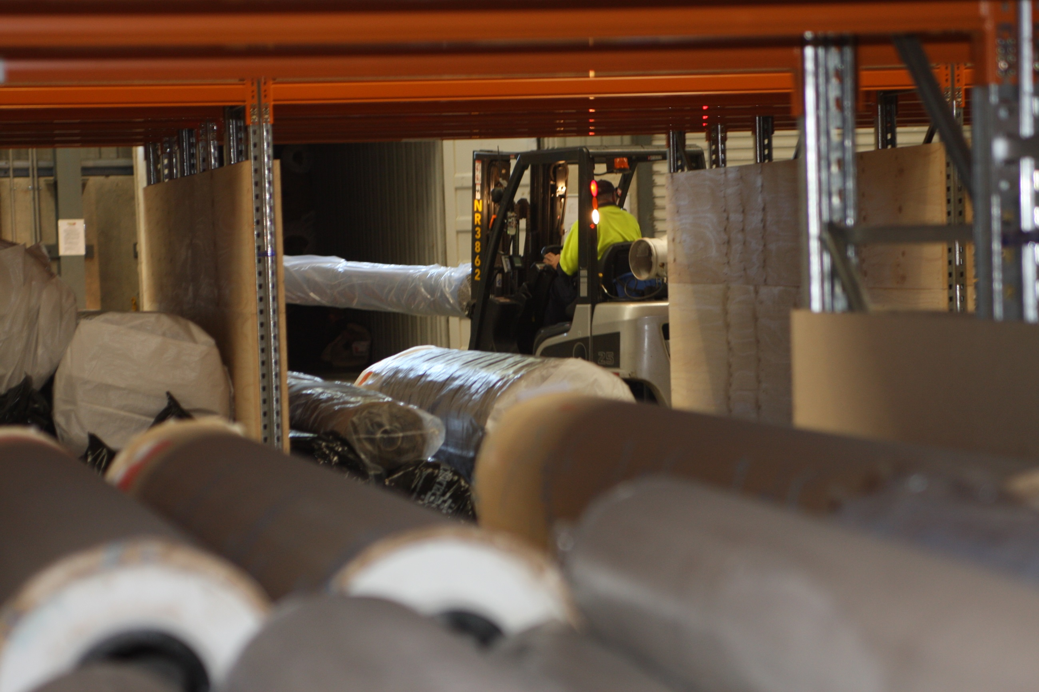
ABOUT GMK LOGISTICS
Established in 1962
(53 years)
Market leader in the provision of warehousing and transport services to the flooring industry
Over 40 years of experience in handling, storing and cutting flooring (vinyl and carpets)
Nation-wide distribution network specialising in flooring products
Commitment to outstanding customer service - DIFOT performance exceeds 99%
Wholly owned subsidiary of CTI Logistics Limited, a transport and logistics company listed on the Australian Stock Exchange
5

Slide 6
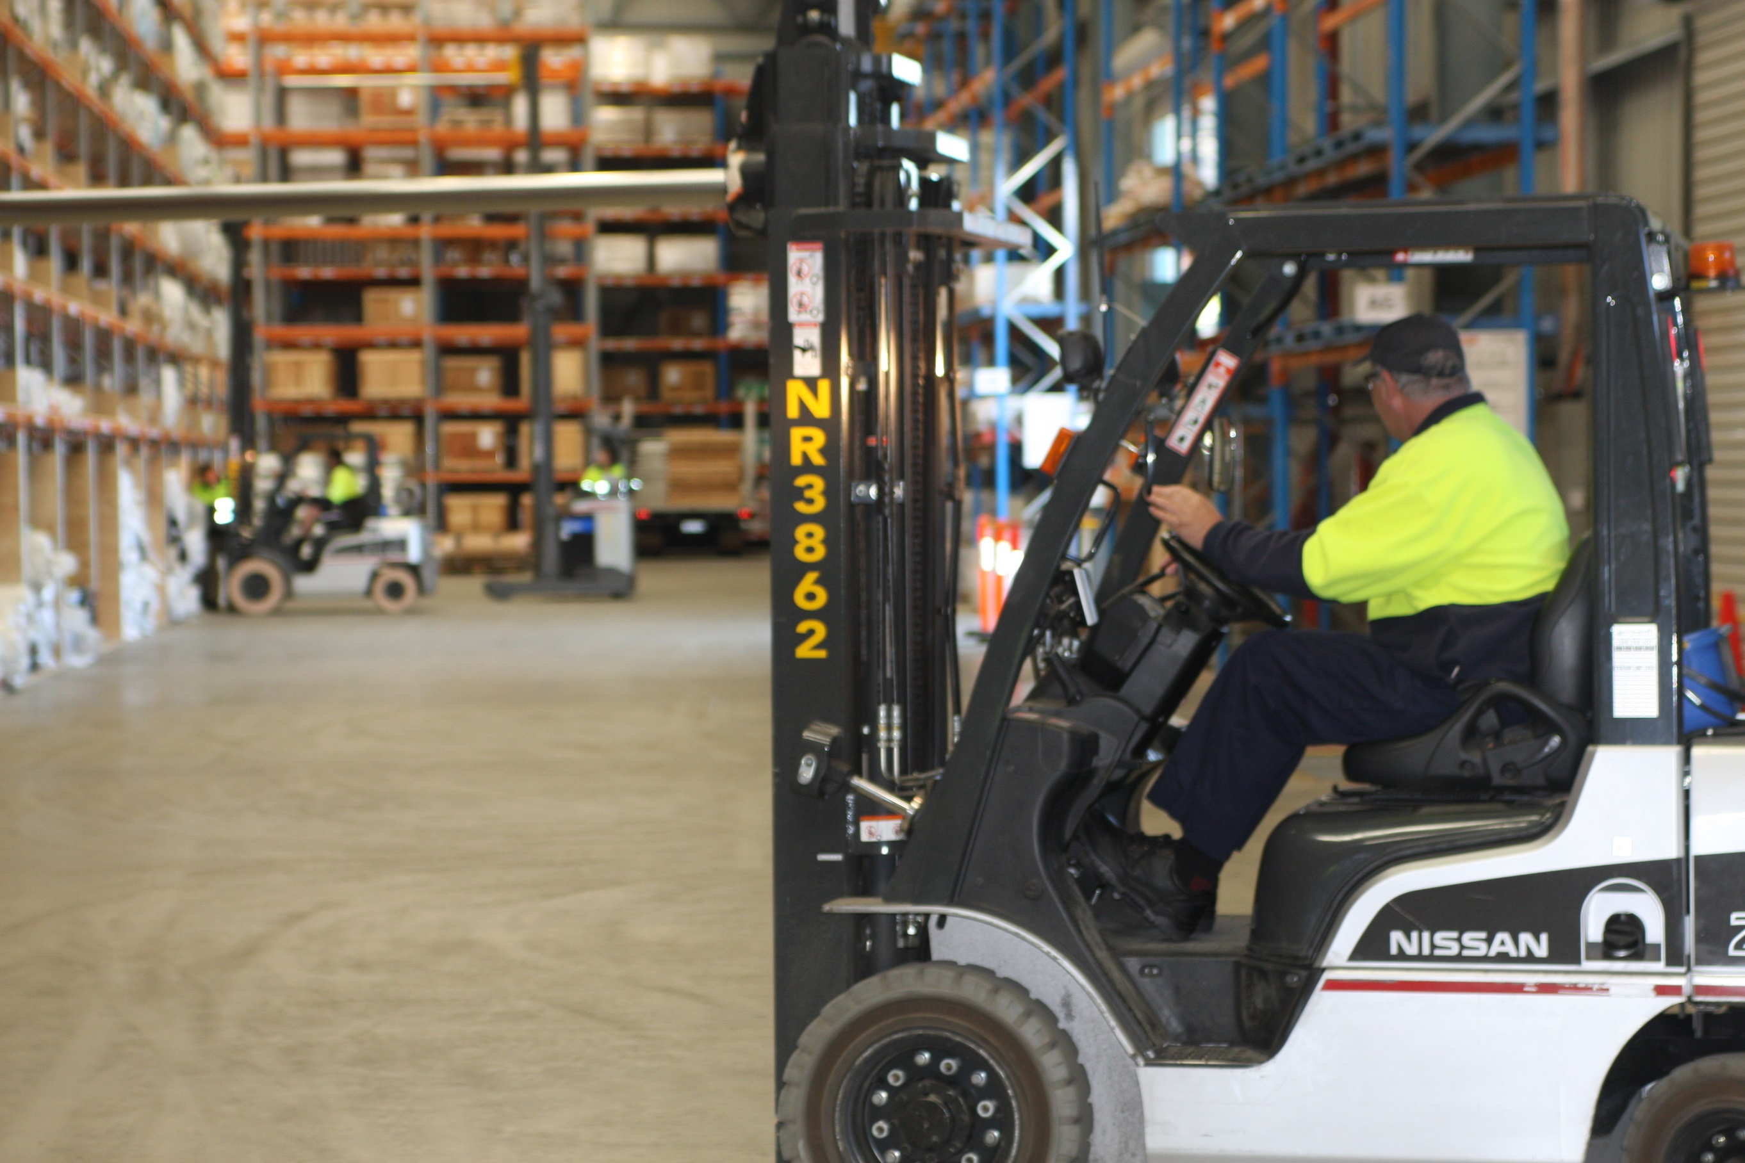
THE GMK DIFFERENCE
Like our clients – we live and breathe the floor covering industry
A highly trained team (145 FTE) with knowledge and experience in the correct way to handle flooring products
Over 50,000 m² of warehousing space nationally - all with recessed docks for efficient for efficient load/unload and designed for the safe and effective handling of flooring products
A fleet of 75 specialised trucks and trailers throughout Australia – customized to handle flooring products safely and to minimise damage
6

Slide 7
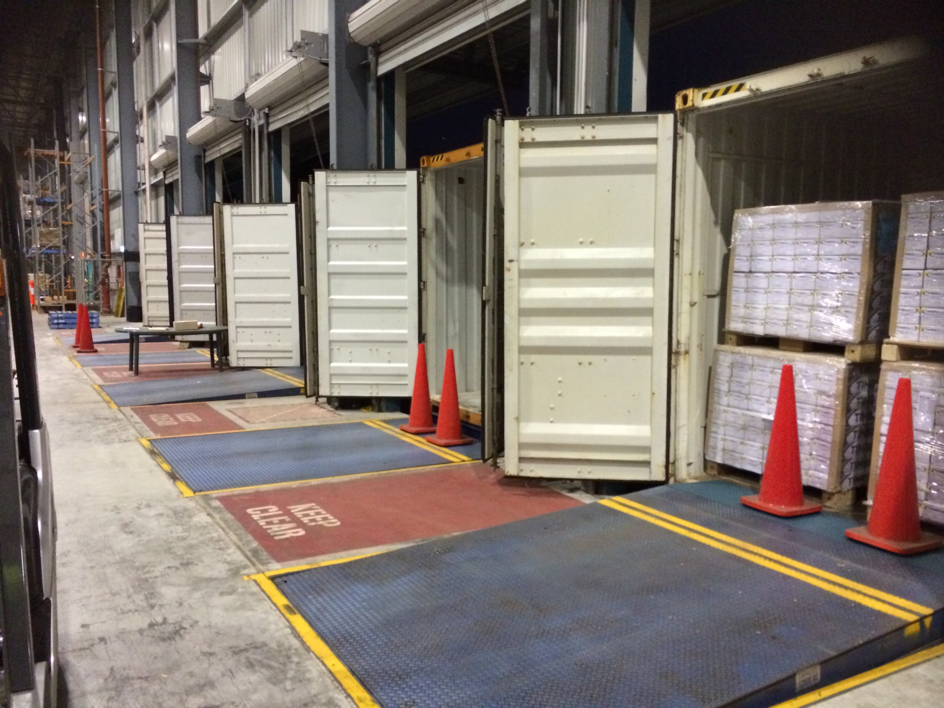

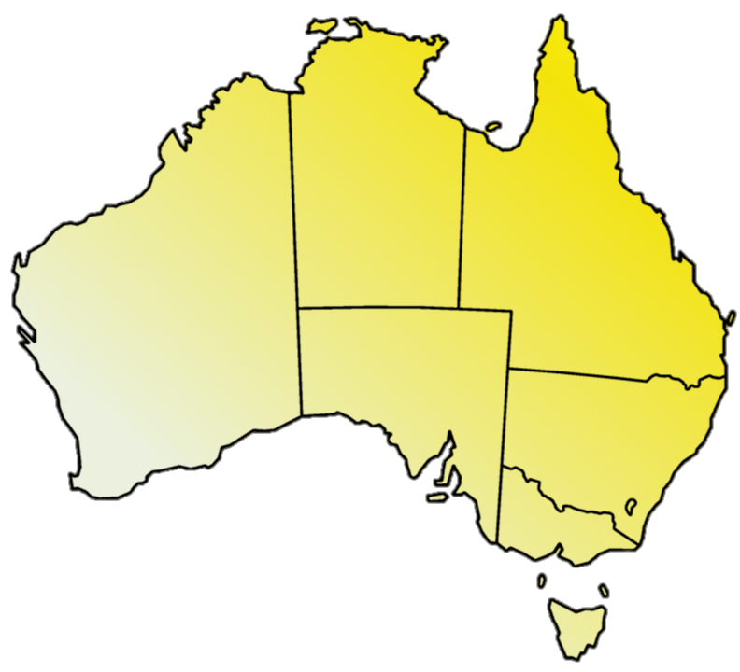
GMK – A NATIONAL INTEGRATED END TO END FLOOR COVERING DISTRIBUTION SYSTEM
  WAREHOUSE LOCATIONS:
  Smeaton Grange, NSW (Head Office)
  Newcastle, NSW
  Laverton North, VIC
  Kewdale, WA
  Pooraka, SA
  Ormeau, QLD
Brisbane
Perth
Adelaide
SYDNEY
Melbourne
7

Slide 8
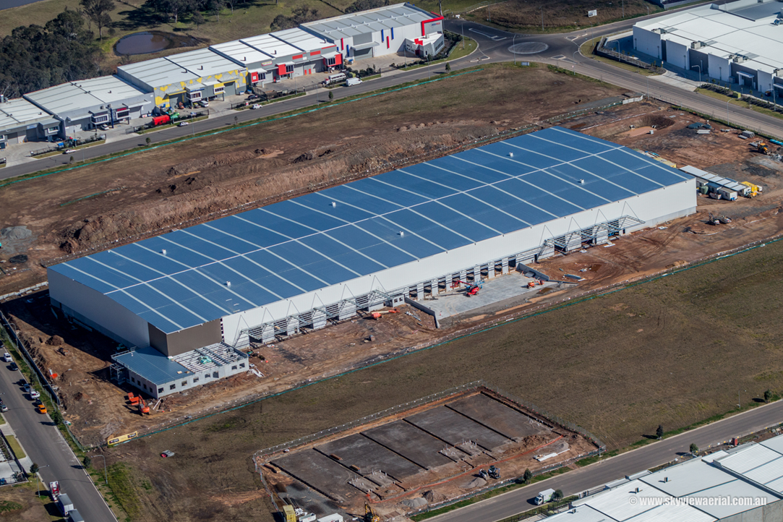
NEW GMK SYDNEY WAREHOUSE
At 13 JULY 2015
16,000 m² facility scheduled to be operational January 2016
Purpose built and designed to handle flooring products
Excellent location, near GMK’s current Sydney site
16 dock capacity
Significant expansion capability
8

Slide 9
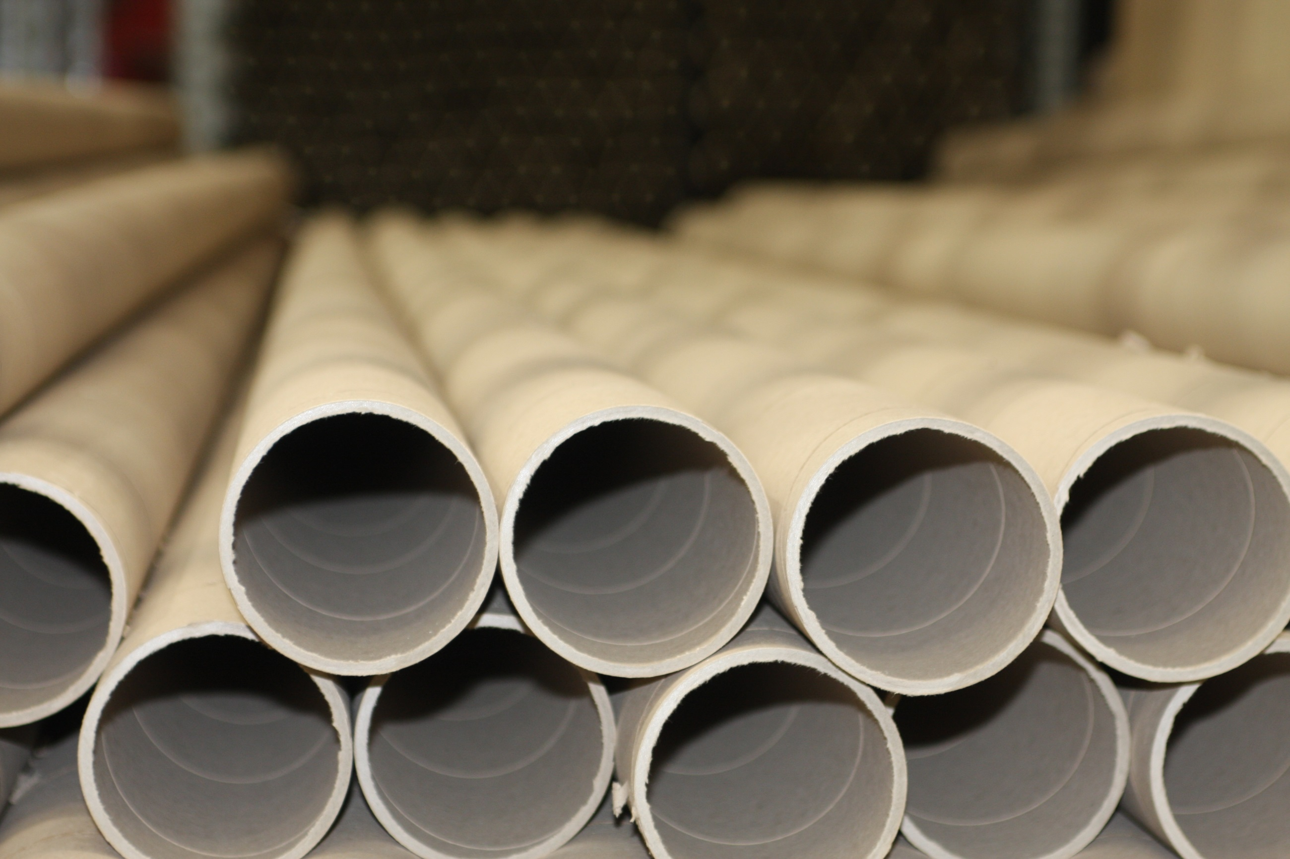
NEW GMK SYDNEY WAREHOUSE BENEFITS
Allows GMK the ability to provide Tarkett with 2 metre and 4 metre roll storage using trays specifically designed for Tarkett product
9

Slide 10
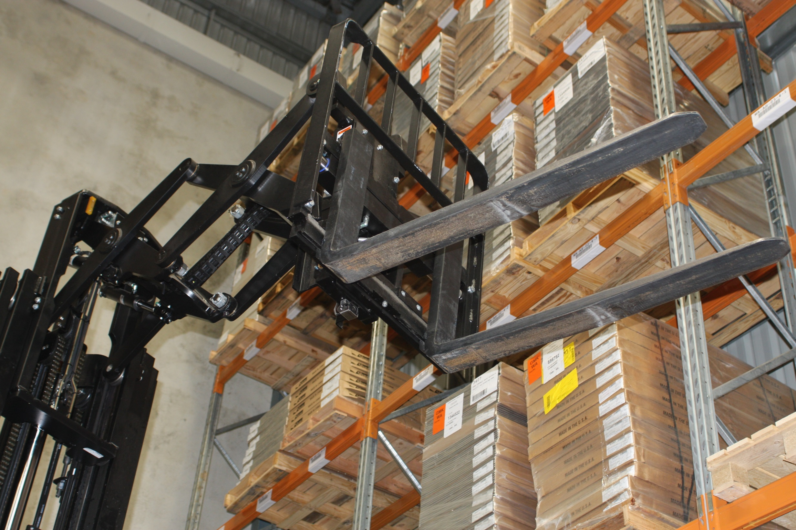
NEW GMK SYDNEY WAREHOUSE BENEFITS
The “state of the art” facility will provide improved day to day operational efficiencies – ensuring a better customer service outcome to Tarkett and its clients
A fully integrated warehousing and transport operation thus reducing costs to Tarkett
Fully compliant materials handling system designed around safety, efficiency and protection of product to mitigate against damage
10

Slide 11

SERVICING TARKETT
Your Account Manager will be David Knagge - 37 years in transport, highly experienced in handling rolled and palletised flooring product
GMK understands Tarkett’s requirements and product, having provided both warehousing and transport to Tarkett for more than 5 years
Tarkett product will be segregated from other customers’ products in our warehouses and access by other parties will be strictly forbidden
GMK will provide Tarkett a highly personalised service, working closely with Tarkett to service all its customers, including major contracts (e.g. Adelaide, Bendigo & Sunshine Coast Hospitals)
11

Slide 12
ROLL PRODUCT COSTINGS
Activity | National Volume | UOM | Rate AU$ | Annual cost AU$
Container unload – 20’ | 194 | Per annum | $210.00 (including put away) | $40,740.00
Container unload – 40’ | 14 | Per annum | $420.00 (including put away) | $5,880.00
Pick fee | 42,765 | Per annum | $1.75 (per roll) | $74,839.00
Cut fee | 11,304 | Per annum | $14.10 (per cut) | $159,386.00
Order fee (electronic) | 9,000 | Per annum | $12.00 (per order) | $108,000.00
Roll storage - 2m | 10,102 | Rolls | $1.60 (per roll per week) | $840,486.00
Roll storage - 4m | 358 | Rolls | $3.20 (per roll per week) | $59,571.00
Weld rod storage | As required |  | $210.00 (per m² per annum) | $ TBA
Consumables | As required |  | GMK standard rates | $ TBA
Total estimated cost |  |  |  | $1,288,902
12

Slide 13
PALLET PRODUCT COSTINGS
Activity | National Volume | UOM | Rate AU$ | Annual cost AU$
Container unload – 20’ | 214 | Per annum | $120.00 (including put away) | $25,680.00
Container unload – 40’ | 57 | Per annum | $240.00 (including put away) | $13,680.00
Handling – pallet pick | 6,872 | Per annum | $3.20 (per pallet) | $21,990.00
Handling – carton pick | 7,993 | Per annum | $0.30 (per carton) | $2,398.00
Order fee | 5,920 | Per annum | $12.00 (per order) | $71,040.00
Pallet Storage | 2,844 | Pallet | $3.05 (per pallet per week) | $451,058.00
Roll storage - 4m | 358 | Rolls | $3.20 (per roll per week) | $59,571.00
Handling – pallet wrap | As required |  | $5.20 (per pallet) | $ TBA
Consumables | As required |  | GMK standard rates | $ TBA
Total estimated cost |  |  |  | $585,846.00
13

Slide 14
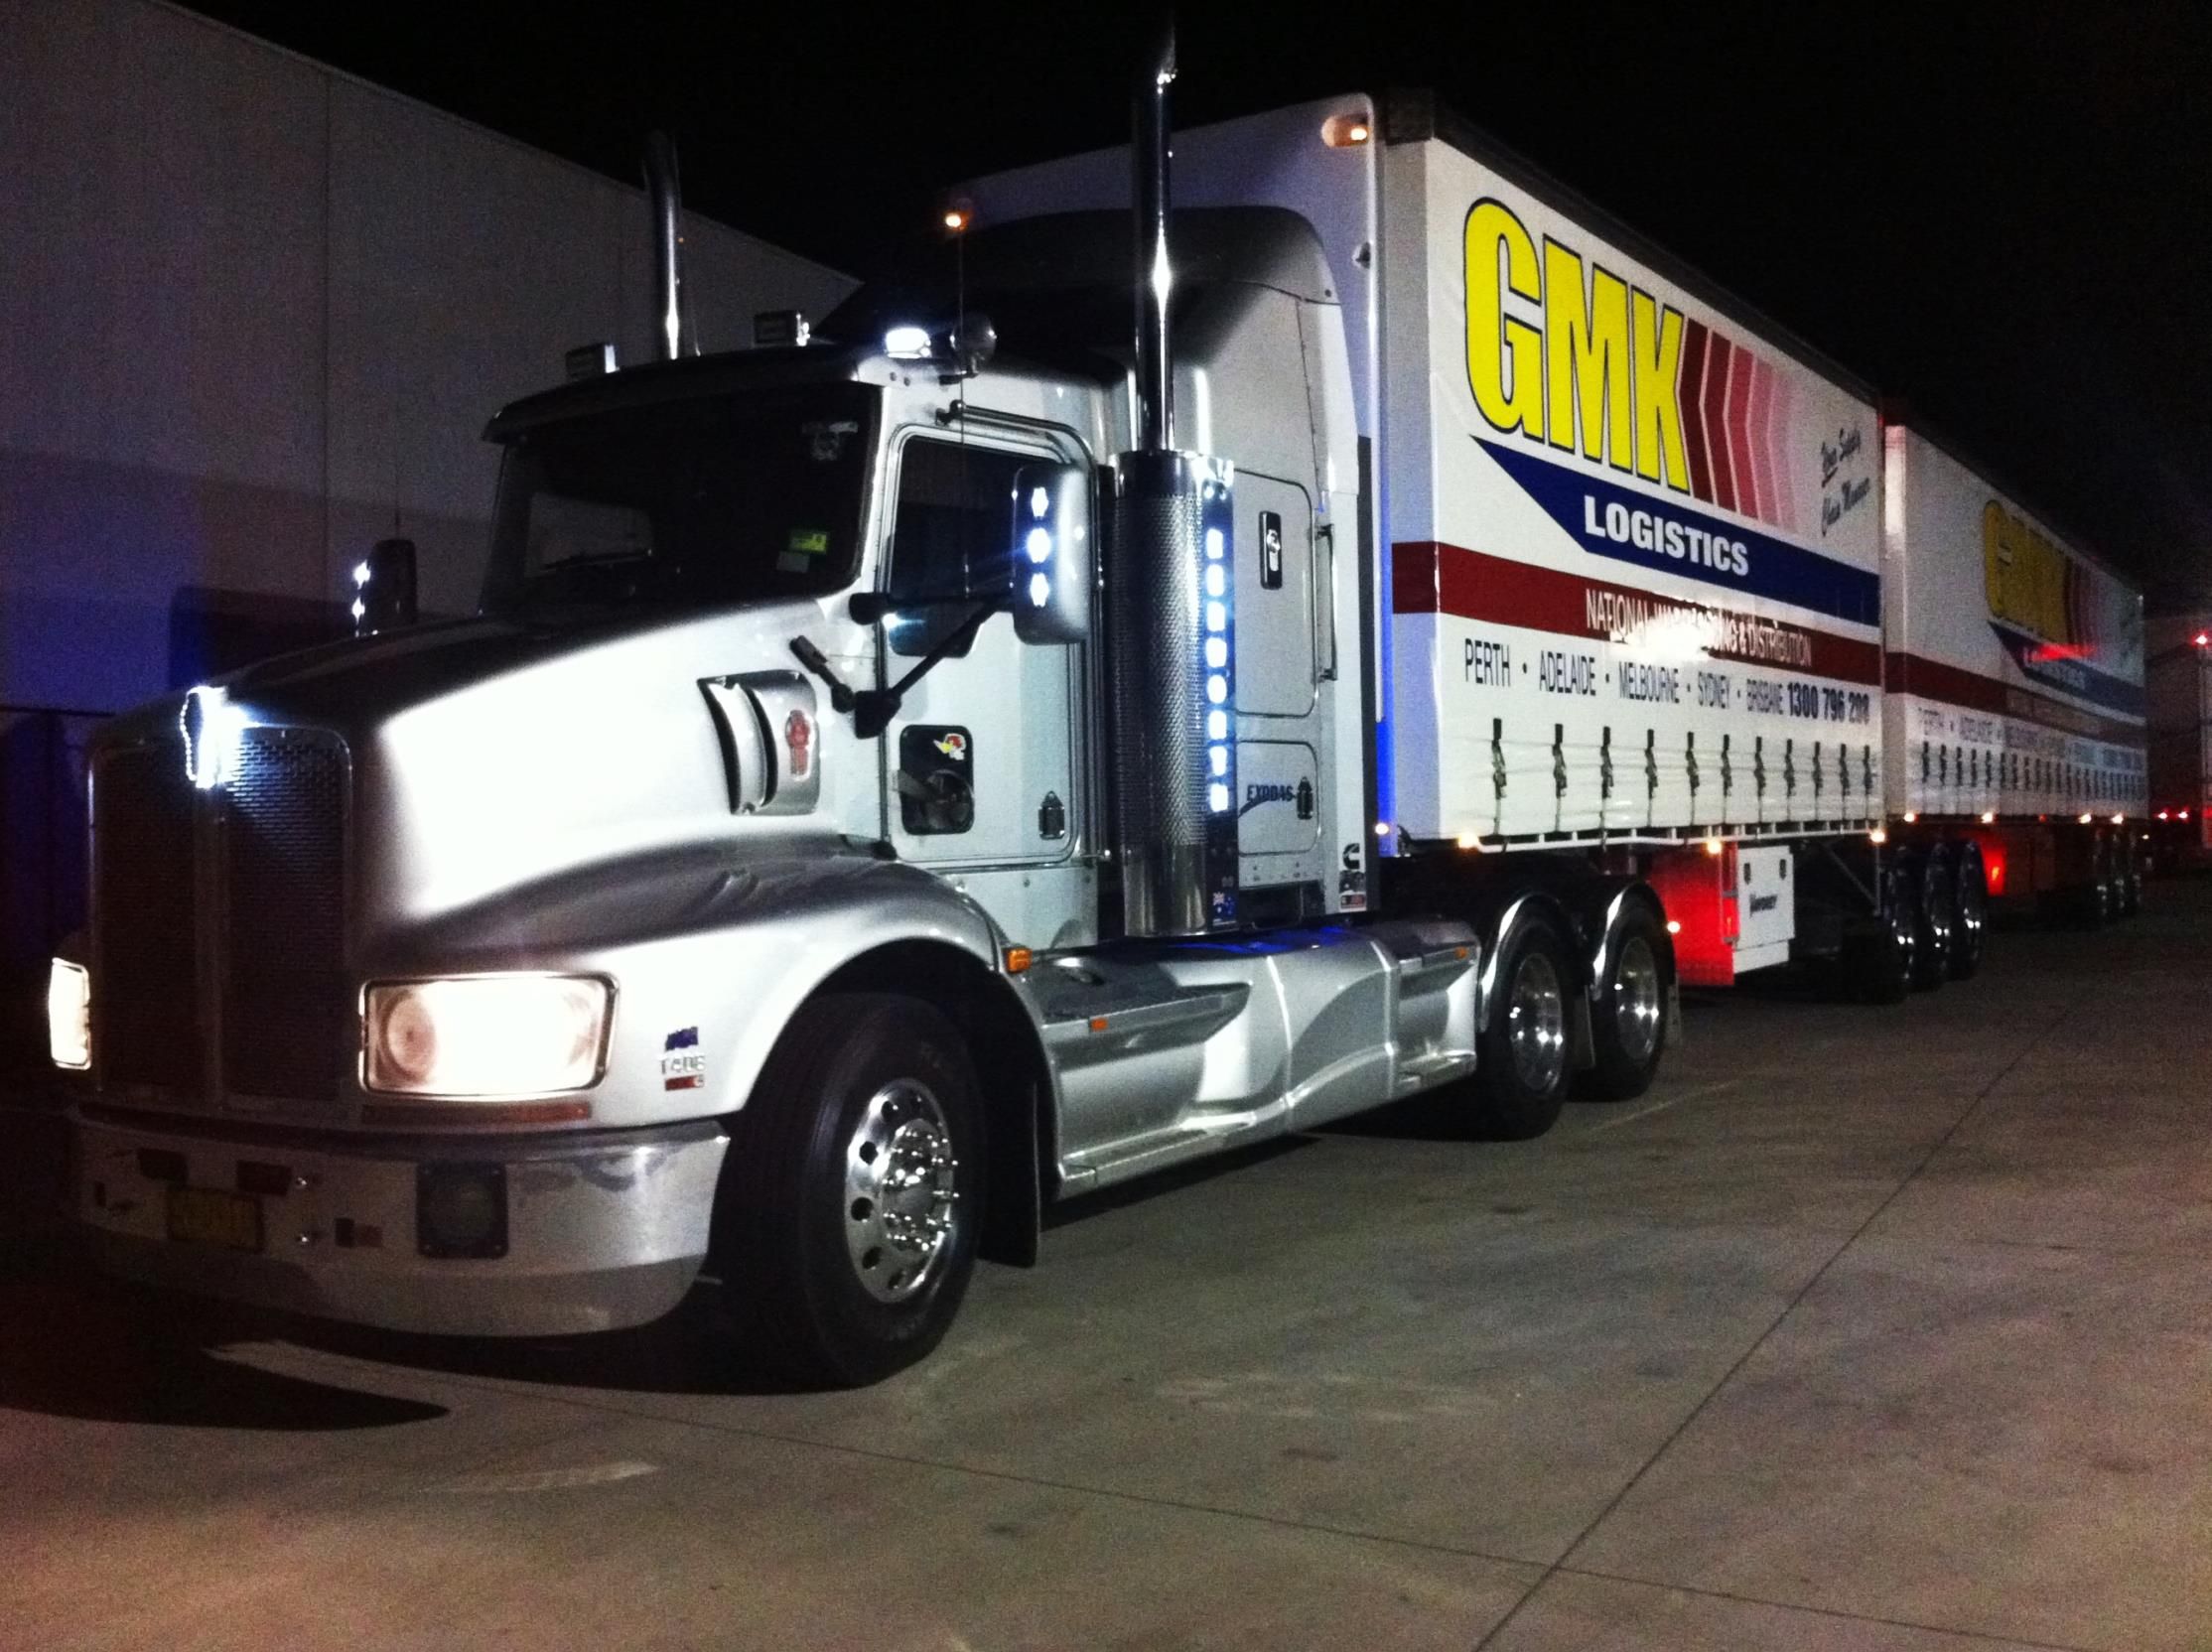
OTHER CONSIDERATIONS
  Warehousing your product at our Sydney facility will result in greater speed to market and lower transport costs (approximately $100,000 p.a.)
  Same day orders within agreed cut off times will be completed at no additional charge
  GMK is prepared to offer employment to two or three Tarkett warehouse staff
  GMK will consider purchasing Tarkett’s cutting machines, pallet tipper, forklifts, racking and associated equipment at market value
  To protect both parties, a 3-5 year contract is proposed
14

Slide 15
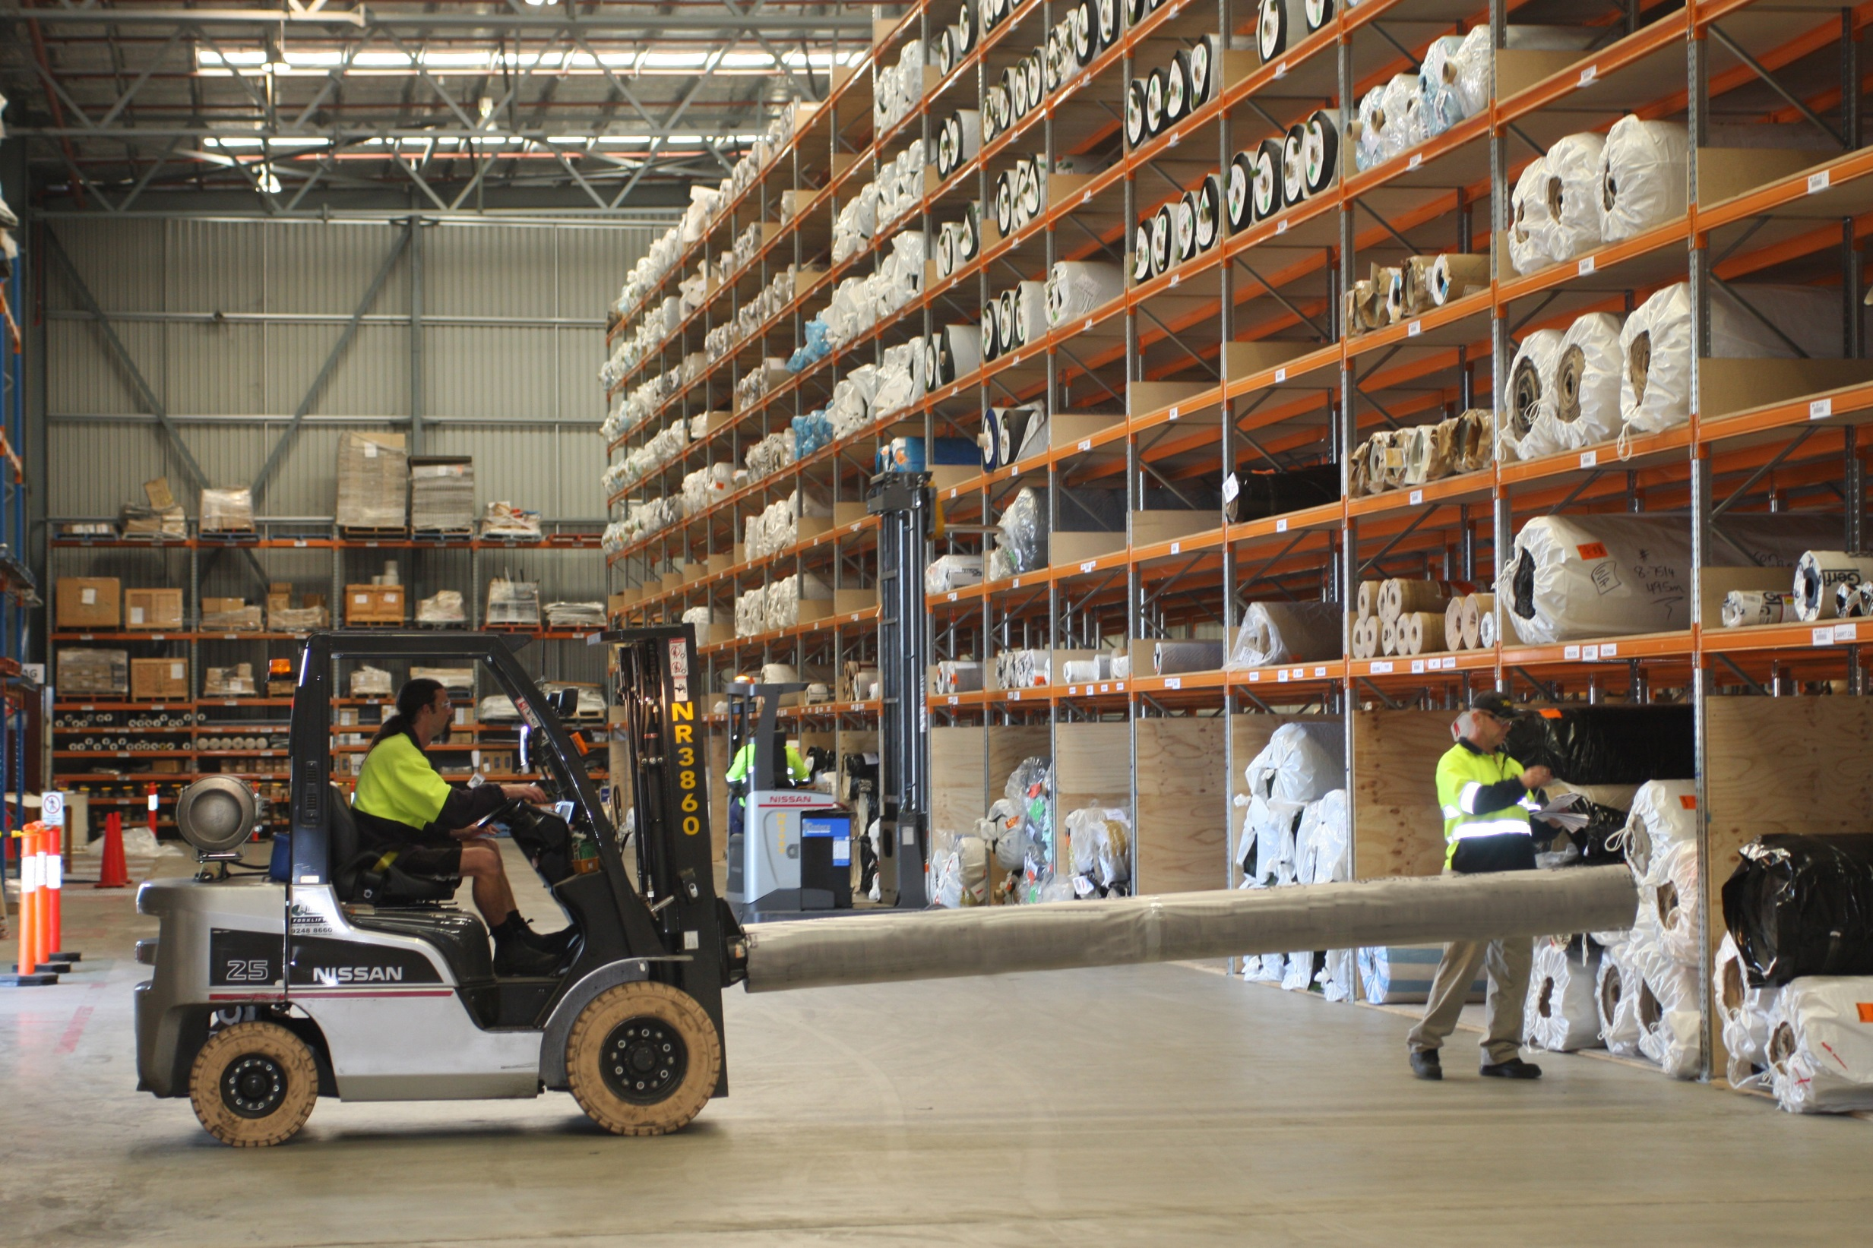
WHY CHOOSE GMK
GMK recognises Tarkett’s leading position in the floor covering industry – we have the flooring industry experience, manpower, equipment and facilities to provide Tarkett a second to none supply chain solution
As a wholly owned subsidiary of CTI Logistics Limited, a publicly listed company that has been a provider of transport and logistics services for more than 40 years, GMK has the financial backing to support the continued growth of Tarkett
We know your product - as Tarkett’s current third party provider of warehousing and transport services – GMK is best positioned to minimise any disruption of service and delivery to Tarkett’s clients
15

Slide 16
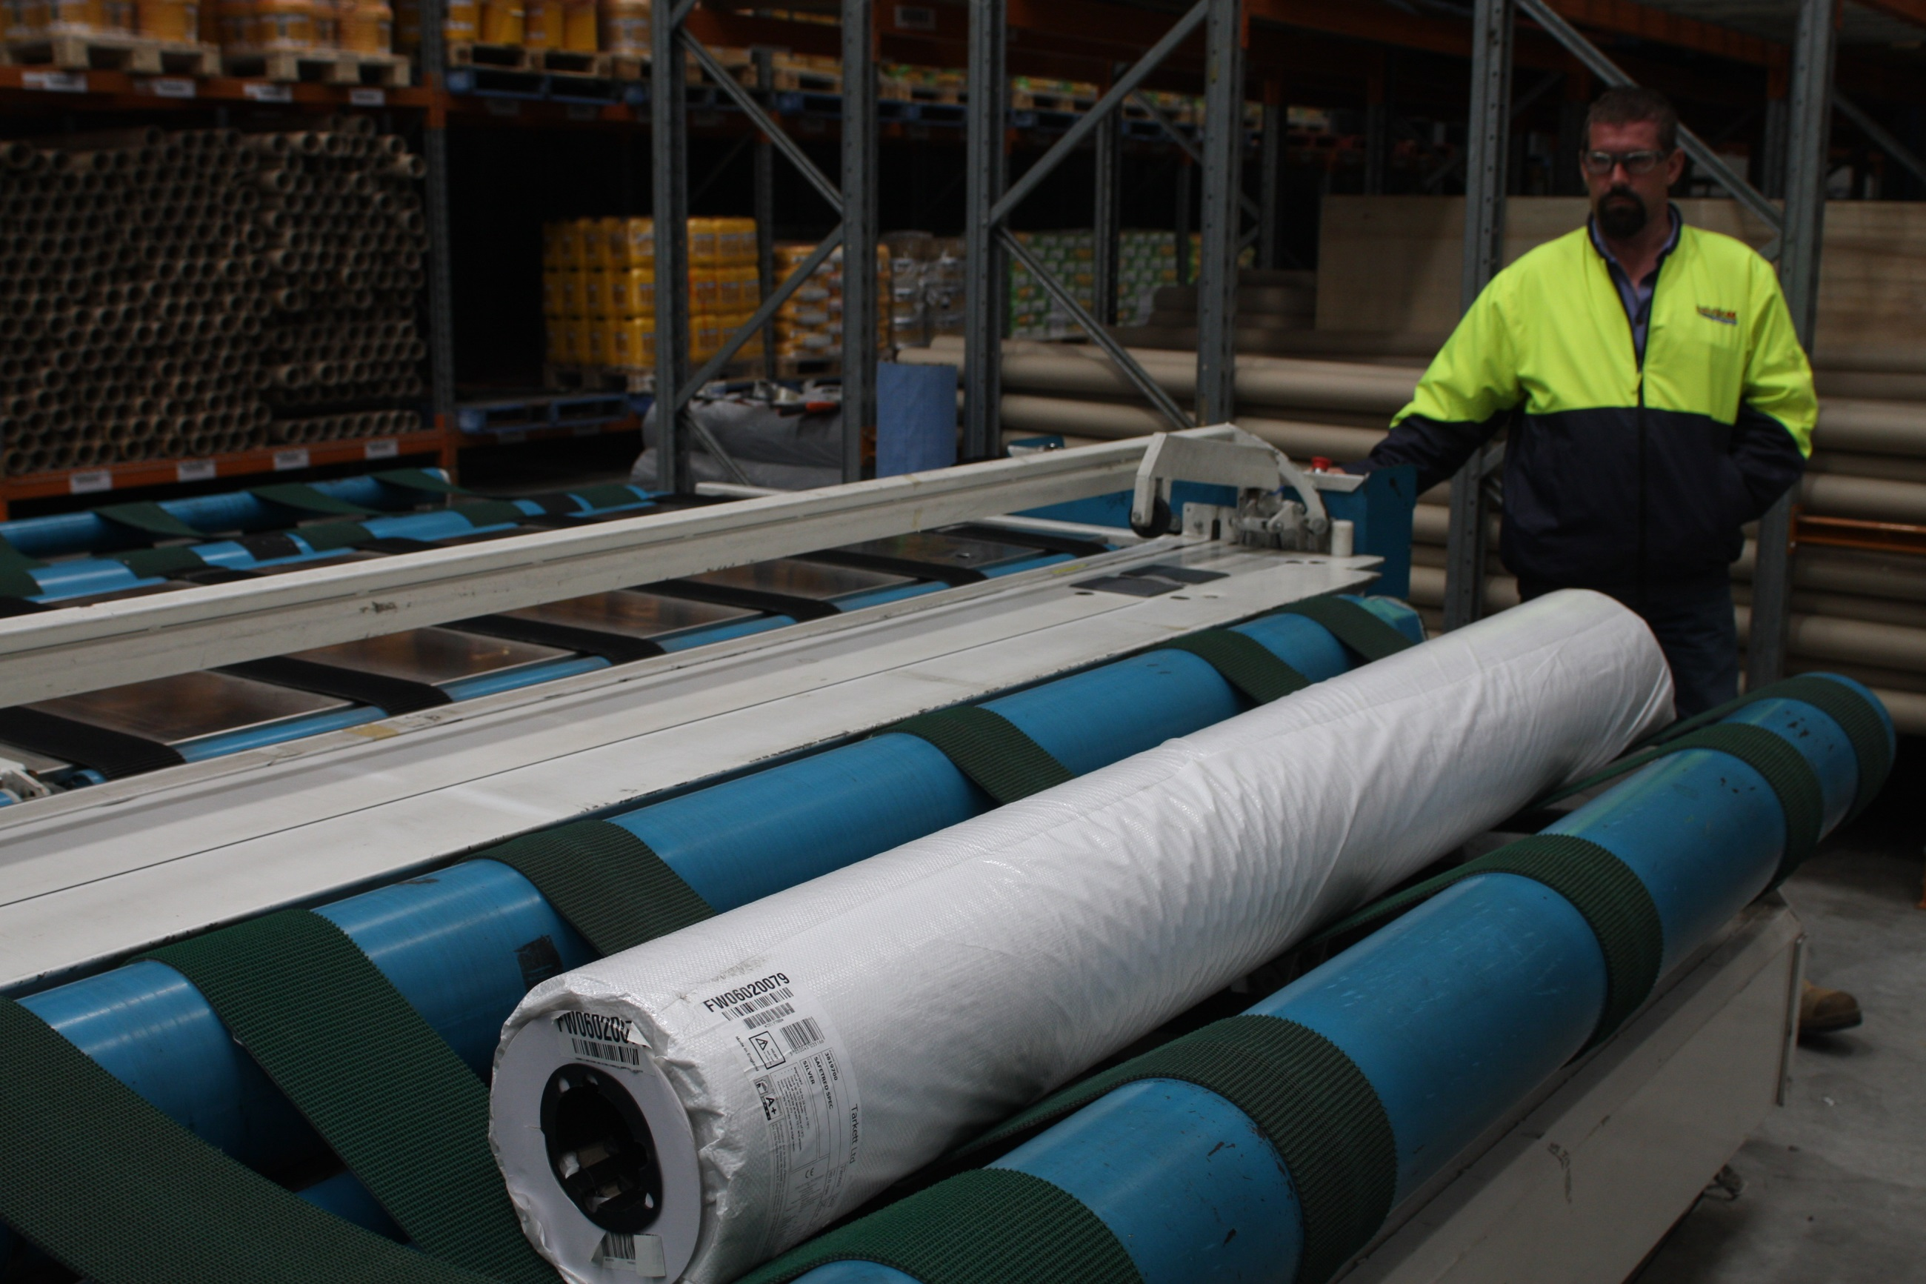
QUESTIONS?
16

